Slide 1
VX 420: Business Basics for Entrepreneurship
The Lean LaunchPad: Customer Segments
Version 6/15/12

Slide 2
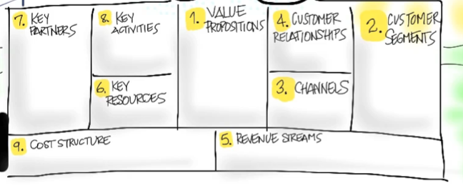
Customer Segments
Who Are They?
Why Would They Buy?

Slide 3
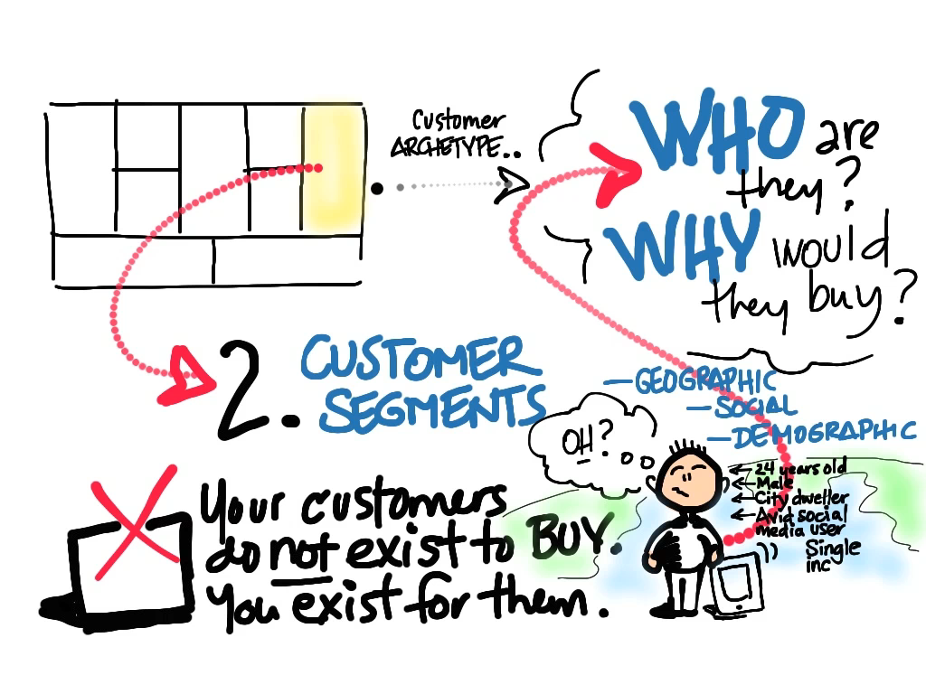
© 2012 Steve Blank

Slide 4
Product/Market
Fit

Slide 5
The Value Proposition
Gain Creators
MVP
Products & Services
Pain Killers

Slide 6
Pain = Customer Problem Gain = Customer Solution

Slide 7
The Customer Segment
Gains
Persona /Archetype
Jobs
Problem or Need
Pains
Market Type

Slide 8
Gain Creators
MVP
Gains
Products & Services
Persona /Archetype
Jobs
Problem or Need
Pain Killers
Pains
Product/Market
Fit

Slide 9
Jobs to Be Done Problems/Needs
What is the customer segment trying to get done?
Is it a problem or a need?

Slide 10
Customer Segments – Jobs/Needs
What functional or social jobs are getting done?
(e.g. perform or complete a specific task, solve a specific problem or trying to look good, gain power or status, ...)
What emotional jobs?
(e.g. esthetics, feel good, security, ...)
What basic needs are you helping your customer satisfy?
(e.g. entertainment, communication, sex, ...)

Slide 11
Buyer/Co-Creator/Transferor
Are they a buyers
(e.g. comparing offers, deciding, buying, taking delivery of a product or service, ...)
Are they co-creators
(e.g. co-designing with solution providers, contributing value to the solution, ...)
Are they transferors'
(how customers dispose of a product, transfer it to others, or resell, ...)

Slide 12
Customer Segment Jobs - Rank
Rank each job according to its significance to the customer.
Is it crucial or is it trivial?
For each job indicate the frequency at which it occurs.
Outline in which specific context a job is done, because that may impose constraints or limitations
(e.g. while driving, outside, ...)

Slide 13
Customer Pains
undesired costs and situations, risks, negative emotions

Slide 14
Customer Segments – Pains
What do your customers find too costly?
(e.g. takes a lot of time, costs too much, requires substantial efforts, ...)
How are current solutions underperforming?
(e.g. lack of features, performance, malfunctioning, ...)
What are the customers main difficulties and challenges?
(difficulties getting things done, resistance, ...)
What’s keeping your customer awake at night?
(e.g. big issues, concerns, worries, ...)

Slide 15
Customer Segments – Pains
What barriers are keeping customers from adopting?
(e.g. upfront investment costs, learning curve, resistance to change, ...)
What makes your customers feel bad?
(e.g. frustrations, annoyances, things that give them a headache, ...)
What risks do customers fear?
(e.g. financial, social, technical risks, or what could go awfully wrong, ...

Slide 16
Customer Gains
benefits the customer expects, desires or is surprised by. includes functional utility, social gains, positive emotions, and cost savings

Slide 17
Customer Segments – Gains
Which savings would make your customer happy?
(e.g. in terms of time, money and effort, ...)
What outcomes do they expect and what would go beyond their expectations?
(e.g. quality level, more of something, less of something, ...)
How do current solutions delight your customer?
(e.g. specific features, performance, quality, ...)
What would make your customer’s job or life easier?
(e.g. flatter learning curve, more services, lower cost of ownership, ...)

Slide 18
Customer Segments – Gains
What positive social consequences do they desire?
(e.g. makes them look good, increase in power, status, ...)
What are customers looking for?
(e.g. good design, guarantees, specific or more features, ...)
What do customers dream about?
(e.g. big achievements, big reliefs, ...)
How does your customer measure success and failure?
(e.g. performance, cost, ...)
What would increase the likelihood of adopting a solution?
(e.g. lower cost, less investments, lower risk, better quality, performance, design, ...)

Slide 19
Customer Persona/Archetype
Notes:
-

Slide 20
Define Customer Archetype/Persona
Who are they?
Position / title / age / sex / role
How do they buy?
Discretionary budget (name of budget and amount)
What matters to them?
What motivates them?
Who influences them?
What do they read/who do they listen to?
Draw a Day in the Life of the customer

Slide 21
Market Type
Notes:
-

Slide 22
Type of Market Changes Everything
Existing Market | Resegmented Market | New Market | Clone Market
Notes:
So why are we going to spend a valuable two hours talking about what type of market we are in?
What possible relevance can it have to how we set up our company and bring our product to market?
- Anyone?

Slide 23
Type of Market Changes Everything
Existing Market | Resegmented Market | New Market | Clone Market
Market
Market Size
Cost of Entry
Launch Type
Competitive Barriers
Positioning
Sales
Sales Model
Margins
Sales Cycle
Chasm Width
Customers
Needs
Adoption
Customers
Needs
Adoption
Finance
Ongoing Capital
Time to Profitability
Finance
Ongoing Capital
Time to Profitability
Notes:
Each “type of market” is radically different
Different ways to size the market opportunity
Different sales costs
Different demand creation costs
Different time to liquidity
Very different capital requirements
And as we’ll see market type choices radically effect the Customer Development process.

Slide 24
Definitions: Four Types of Markets
Existing Market | Resegmented Market | New Market | Clone Market
Existing Market
Faster/Better = High end
Resegmented Market
Niche = marketing/branding driven
Cheaper = low end
New Market
Cheaper/good enough can create a new class of product/customer
Innovative/never existed before
Clone Market
Local adaptation
Notes:
In looking at how companies succeed and fail, their success tends to be organized around groupings of customers and markets.
More importantly it is how these groupings of customers view their needs and how your new product satisfies those needs

Slide 25
Market Type
 | Existing | Resegmented | New | Clone
Customers | Known | Possibly Known | Unknown | Possibly Known
Customer Needs | Performance | Better fit | Transform-ational improvement | Local version
Competitors | Many | Many if wrong, few if right | None | None
Risk | Lack of branding, sales and distribution ecosystem | Market and product re-definition | Evangelism and education cycle | Misjudge local needs
Examples | Google | Southwest | Groupon | Baidu
Market Type determines:
Rate of customer adoption
Sales and Marketing strategies
Cash requirements

Slide 26
Market Type - Existing
Incumbents exist, customers can name the mkt
Customers want/need better performance
Usually technology driven
Positioning driven by product and how much value customers place on its features
Risks:
Incumbents will defend their turf
Network effects of incumbent
Continuing innovation

Slide 27
Market Type – Resegmenting Existing
Low cost provider (Southwest)
Unique niche via positioning (Whole Foods)
What factors can:
you eliminate that your industry has long competed on?
Be reduced well below the industry’s standard?
should be raised well above the industry’s standard?
be created that the industry has never offered? (blue ocean)

Slide 28
Market Type – New
Customers don’t exist today
How will they find out about you?
How will they become aware of their need?
How do you know the market size is compelling?
Which factors should be created that the industry has never offered? (blue ocean)

Slide 29
Market Type – Clone
Takes foreign business model and adapts it to local conditions
Language
Culture
Import restrictions
Local control/ownership
Need market large enough >100 million

Slide 30
Corporate Customers
Business to Business (B to B)

Slide 31
What do they want you to do?
Increase revenue?
Decrease costs?
Get them new customers?
Keep up with or pass competitors?
How important is it?

Slide 32
Market Type & Ignoring Customers
Existing Market?
Resegmenting an Existing Market?
niche or low cost
New Market?
When do I ignore customer feedback?

Slide 33
Who’s the Customer in a Company?
User?
Influencer?
Recommender?
Decision Maker?
Economic Buyer?
Saboteur?
Archetypes for each?

Slide 34
How Do They Interact to Buy?
Organization Chart
Influence Map
Sales Road Map

Slide 35
Pass/Fail Signals & Experiments
How do you test interest?
Where do you test interest?
What kind of experiments can you run?
How many do you test?

Slide 36
How Do They Hear About You?
Demand Creation
Network effect
Sales

Slide 37
Consumer Customers
Business to Consumer (B to C)

Slide 38
What do they want you to do?
Does it entertain them?
Does it connect them with others?
Does it make their lives easier?
Does it satisfy a basic need?
How important is it?
Can they afford it?

Slide 39
Market Type & Ignoring Customers
Existing Market?
Resegmenting an Existing Market?
niche or low cost
New Market?
When do I ignore customer feedback?

Slide 40
Consumer Customers
Do they buy it by themselves?
Do they need approval of others?
Do they use it alone or with others?

Slide 41
How Do They Decide to Buy?
Demand Creation
Viral?
SEO/SEM
Network effect?
AARRR (Dave McClure)

Slide 42
Pass/Fail Signals & Experiments
How do you test interest?
Where do you test interest?
What kind of experiments can you run?
How many do you test?

Slide 43
The Consumer Sales Channel
A product that’s bits can use the web
But getting a physical consumer product into retail distribution is hard
Is Wal-Mart a customer?
More next week

Slide 44
Multi-Sided Markets
Business to Business to Consumer
(B to B to C)

Slide 45
Who’s The Customer?
Consumer End Users, Corporate Customers Pay
Multiple Consumers
Etc.

Slide 46
Multiple Customer Segments
Each has its own Value Proposition
Each has its own Revenue Stream
One segment cannot exist without the other
Which one do you start with?

